Slide 1
Movie Recommendation with Natural language processing
By Gideon blinick

Slide 2
Background
The problem I am solving is how can I provide a user with movies they want to see, assuming that I am provided with a movie that I know the user already knows and likes?
The client is any user that likes movies and wants to see more movies that they like.
The motivation for this problem is my own experience. I enjoy a good movie now and then but it is hard to know what to see. Using rating websites is not always a reliable way of finding great movies. An approach that takes into account my preferences is optimal.

Slide 3
Formulation of the problem as a data science problem
Movie Recommendation is, naturally, a recommendation problem.
Recommendation problems fall under neither Supervised Learning nor Unsupervised Learning, but rather are information retrieval problems [1].
There are generally 2 types of recommender systems:
Content-based: make recommendations based on the content of an item/thing itself (i.e. you like item A, so you’ll probably like item B which is very similar to item A).
Collaborative-based: make recommendations based on a user profile (i.e. your profile is similar to person A, and I know he likes bananas, so I will recommend bananas to you).
My recommender systems are content-based. A user provides a movie and the recommendations returned are entirely based on the provided movie, not the users’ profile.

Slide 4
Dataset description
I assembled my own dataset from IMDb data.
The first data source I used was IMDb’s public datasets. There is a lot of data there, but unfortunately no text data. So I needed another way of obtaining text data describing movies.
That’s when I found the IMDbPY API. It allowed me to pull plot summaries and plot keywords directly from IMDb.
I used the public datasets to get the top 10,000 movies by number of reviews. I then pulled the plot summary and plot keywords for those movies from IMDb.

Slide 5
Data wrangling
There wasn’t too much to do in this stage.
All the tables from the public datasets that I used had a movie ID column that made joining them very easy.
Furthermore, when I pulled text data via the API, I simply used the movie IDs that I already had.

Slide 6
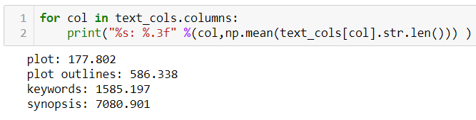
Exploratory data analysis
First, I looked at the average length (by number of characters) for each of the 4 text columns that I pulled: plot, plot outline, keywords, and synopsis.
I found that synopsis contained the most characters, followed by keywords, followed by plot outlines, followed by plot.
At this point, I made the decision to just analyze plot outlines and keywords. I chose plot outlines because it wasn’t too long or short and keywords because it had the richest info.

Slide 7
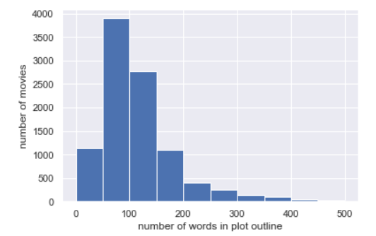
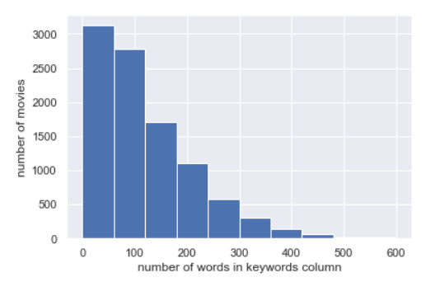
Exploratory data analysis
Next, I looked at the distributions of the number of words for keywords and plot outlines.
When looking at the summary statistics for these distributions, I found that the mean number of words for keywords is only slightly greater than the number of words for plot outline (~122 vs. ~115).
This is misleading however, since most keywords are compound words (e.g. "dc-comics").

Slide 8
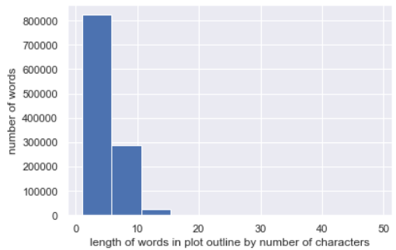
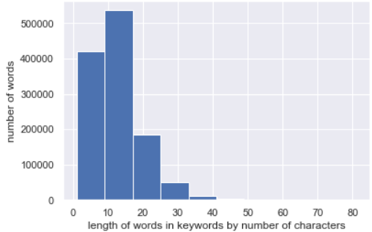
Exploratory data analysis
When I plotted the lengths of words for plot outlines and keywords, I obtained a result that shows the difference between the 2 columns.
The length of words in the keywords column is far greater, on average, than the length of words in the plot outlines column.
This makes sense. Keywords by their nature are meant to be descriptive (‘information rich’) and such words are longer.

Slide 9
modelling
I used keywords for the model based on finding that they were best from EDA.
Most of the normal preprocessing steps for text did not need to be performed:
Tokenization: keywords already comma-separated
Lowercasing: already lowercased
Removing stop words and punctuation: keywords do not have either so no need.
Lemmatizing: this is something I considered doing. I decided not to after seeing how the meaning changed for a variety of lemmatized words. For example, “avengers” (the superhero team) became “avenger”. In my opinon, more information is lost than gained by lemmatizing in this case.
I created 3 different recommender models: a Tf-idf model with cosine similarity, a Jaccard recommender model, and a word-count cosine similarity model

Slide 10
1st Model: Tf-idf with Cosine Similarity
Tf-idf stands for term frequency-inverse document frequency and is a way of assigning importance to words in a document based on how often they appear in that document and in the other documents in a corpus (here corpus just means ‘collection of documents’). Tf-idf allows you to get a sense of what a document is about by seeing what words are most important in it.
I created the model using Gensim (using the Dictionary and TfidfModel classes)
Cosine similarity works by measuring the cosine of the angle between 2 vectors. In my case, the vectors I was using were each movie’s keywords representations in my tf-idf model.

Slide 11
1st Model: Tf-idf with Cosine Similarity
The steps this model takes when recommending movies then is as follows:
Retrieve the movie’s keywords;
Convert those keywords into a bag-of-words model;
Convert the bag-of-words model into a tf-idf representation of those words;
Find the n most similar movies to the movie’s representation by using cosine similarity to calculate the similarity between every movie and the given movie and return the top n results.
Note that the model can be used to find the most similar movies for any given set of keywords.

Slide 12
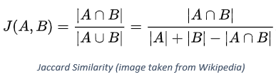
2nd Model: Jaccard Similarity
Jaccard similarity is defined as the intersection of 2 sets divided by the union of those sets. So this model finds the similarity between 2 movies by dividing the number of common keywords between 2 movies by the number of unique keywords in the union of the movies’ keywords.
Mathematically, this is given as:
Note that there is no need for document vectors here as there was for finding cosine similarity.

Slide 13
3rd Model: Cosine Similarity Between Word Counts
My last model is similar to my first model in that it calculates cosine similarity between 2 movie vectors.
However, unlike the first model, here each movie vector is defined by simple word counts (that is, the number of times each word appears for a given movie) rather than tf-idf.
This alternate implementation is performed with the CountVectorizer class in scikit-learn which converts a collection of text documents (i.e. keyword lists in this case) into a matrix of token counts.

Slide 14
Discussion and next steps
When using the models with a few movies with which I am familiar, I get recommendations that are good matches.
A good example to use is Marvel Studios’ 2012 movie “The Avengers”.
Here are the top 5 results I get using each model:
1st Model: Avengers: Age of Ultron, Avengers: Infinity War, Iron Man 2, Captain America: Civil War, Captain America: The Winter Soldier
2nd Model: Avengers: Age of Ultron, Avengers: Infinity War, Captain America: The Winter Soldier, Captain America: Civil War, Thor: The Dark World
3rd Model: Avengers: Infinity War, Avengers: Age of Ultron, Captain America: Civil War, Iron Man 2, Justice League

Slide 15
DISCUSSION and Next steps
The most obvious problem with the models as they currently exist is they do not have evaluation metrics.
To be fair, this is something of an issue for all recommender systems.
My first next step then would be to come up with evaluation criteria by which I could compare the models and by which I could improve them.
The next thing I would do after that is put the models into production. This follows general machine learning best practice of putting simple models into production as fast as possible.
I would use Flask for deployment.

Slide 16
DISCUSSION and next steps
My 3rd improvement would be to incorporate non-text features into the model to use for recommendation.
IMDb has many features in their public datasets and available via IMDbPY and I was initially going to use 4 numeric ones (year of release, runtime, number of reviews, and rating) as well as what genre the movie belongs to (a categorical feature).
A 4th improvement would be clustering the movies for better insight into the data (better EDA).
A 5th improvement would be creating additional models that use other notions of similarity and seeing how they compare across various evaluation criteria.

Slide 17
References
[1] https://www.quora.com/Where-do-recommender-systems-fall-in-machine-learning-approaches
Reference Material on Cosine Similarity with a td-idf Model: https://www.oreilly.com/learning/how-do-i-compare-document-similarity-using-python
Reference Material on Jaccard and Cosine Similarity Models with Text Data: https://towardsdatascience.com/overview-of-text-similarity-metrics-3397c4601f50

